Slide 1
Problem Statement :
In Pharmaceutical companies,they maintain the tempertures of the capsules in the range of threshold values.If these threshold values crosses their limits,then there will be a huge loss to the companies.
So,to minimize this loss,we come up with a solution by using IOT.

Slide 2
Solution:
We designed a solution in such a way that,whenever the temperature crosses the range of threshold values,the company owner will receive an alert of warning message either through SMS or through Email.So that He/She can immediately set the temperature back to its threshold limits.By this,the loss will be decreases.

Slide 3
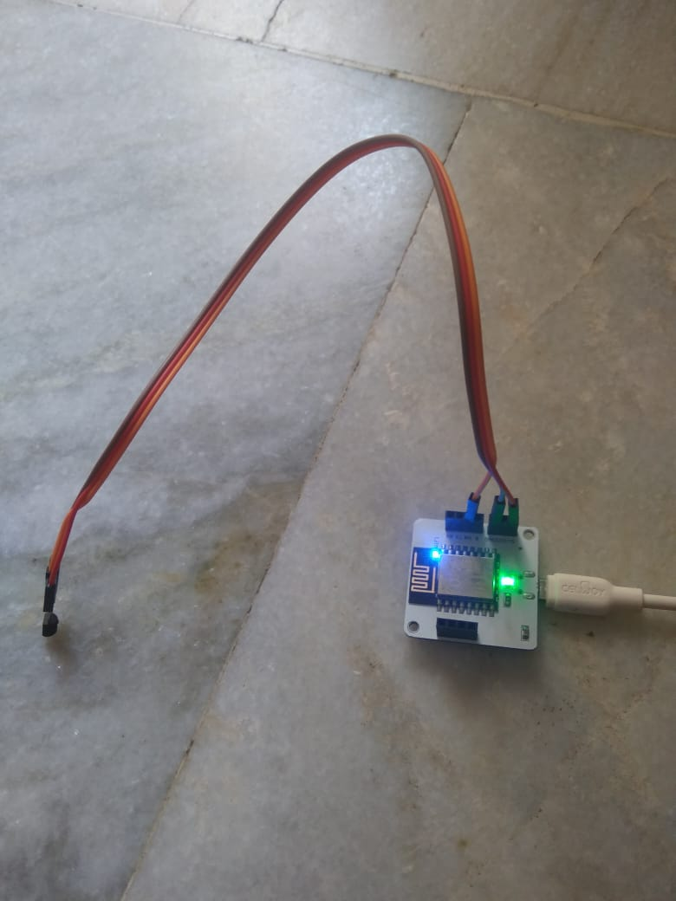
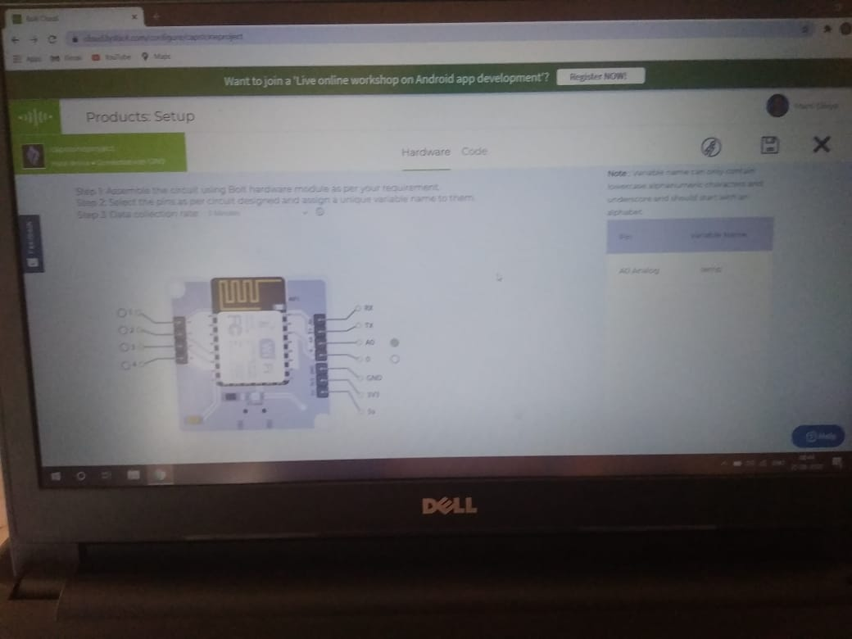
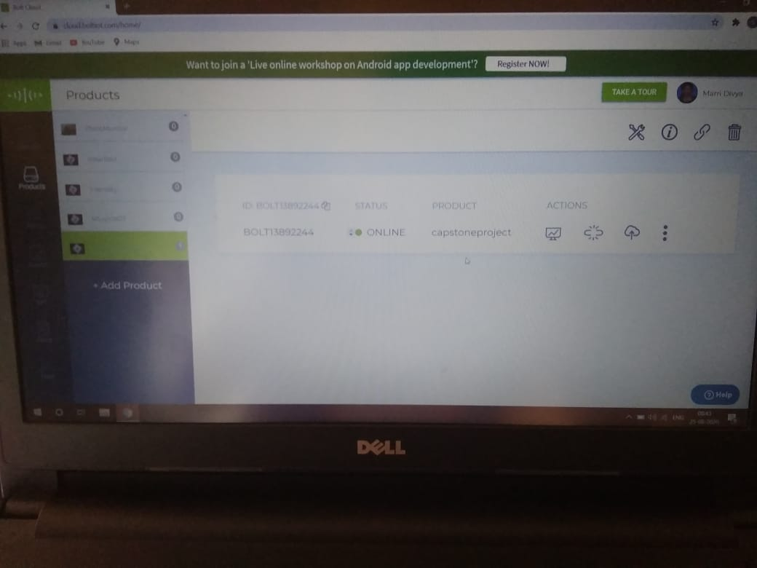
Here are some of the shots that taken while doing the project
Circuit Connections
Creation of Product on BOLT Cloud

Slide 4
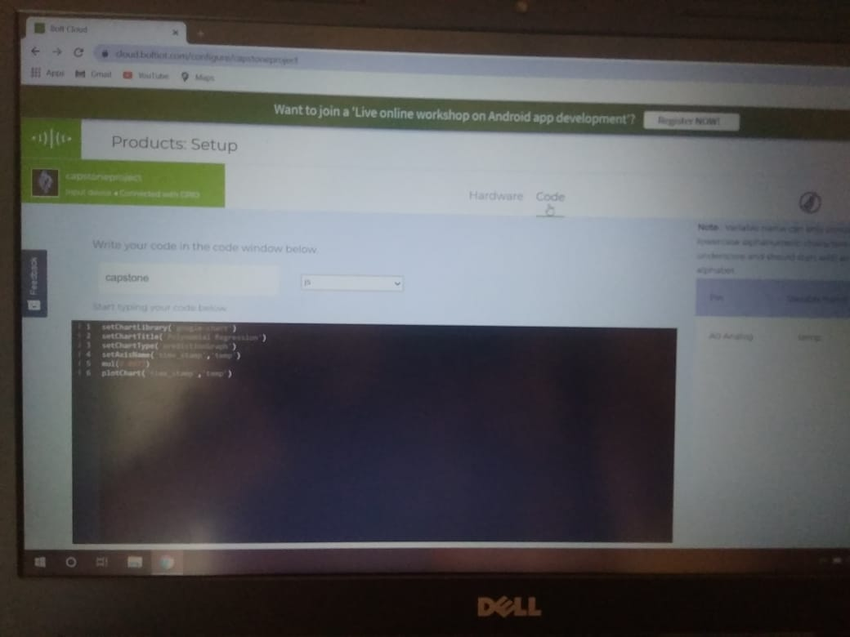
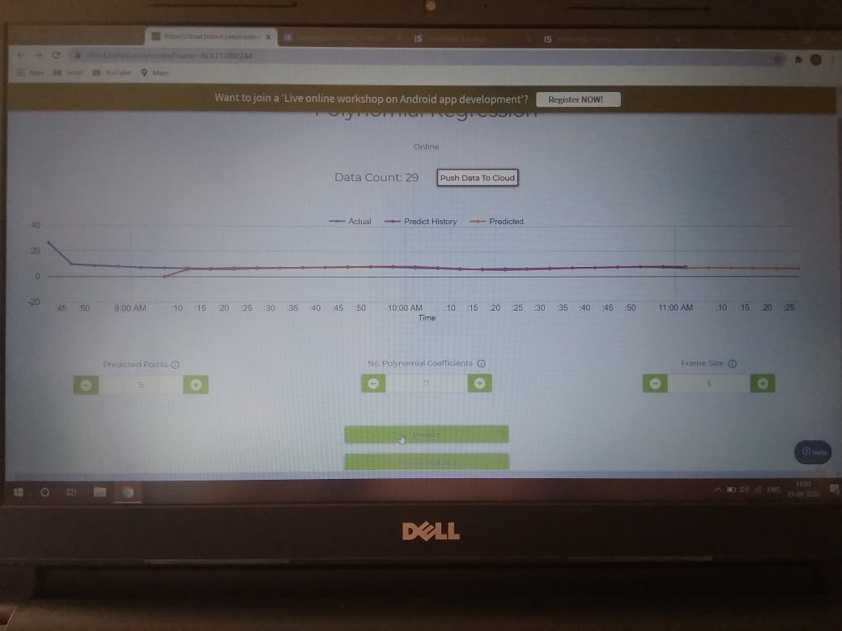
GRAPH
Code for Polynomial Regression

Slide 5
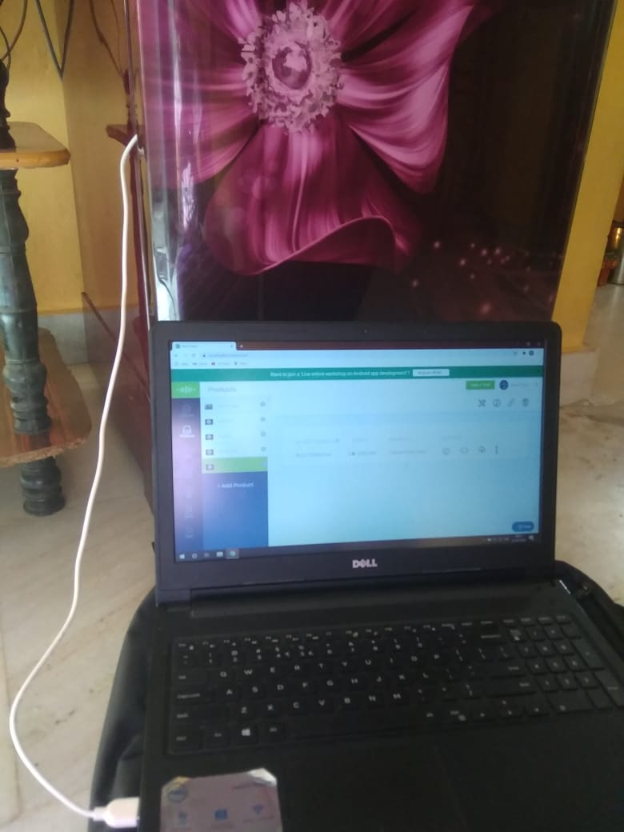
Setting up the Circuit inside the Refridgerator.

Slide 6
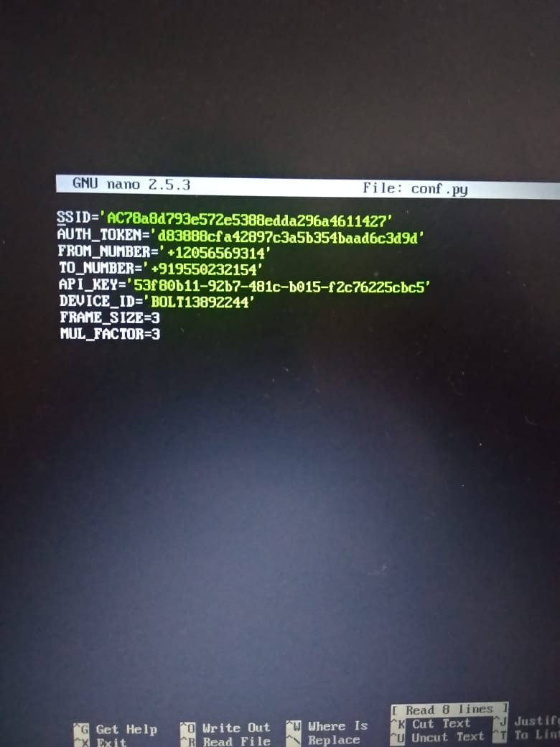
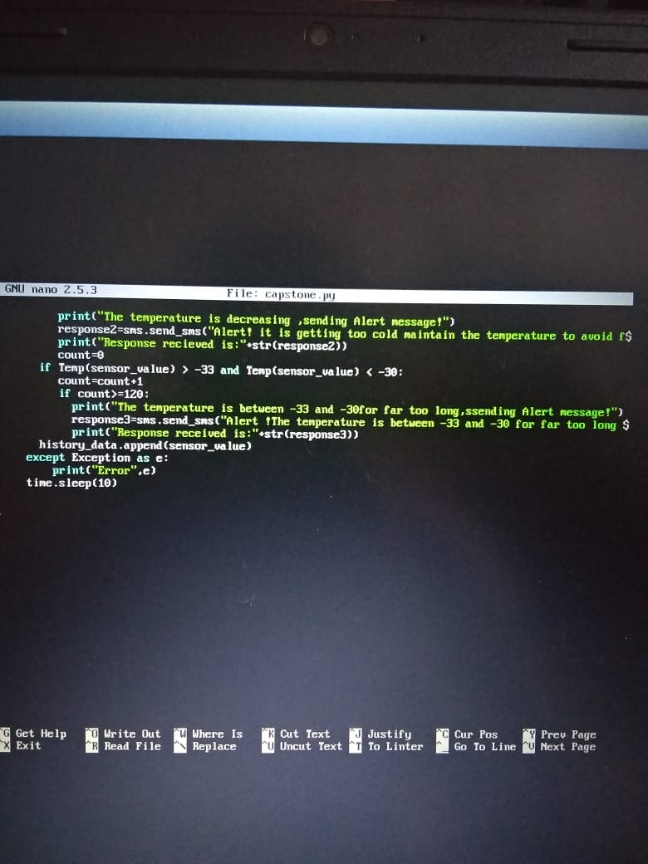
PYTHON CODE

Slide 7
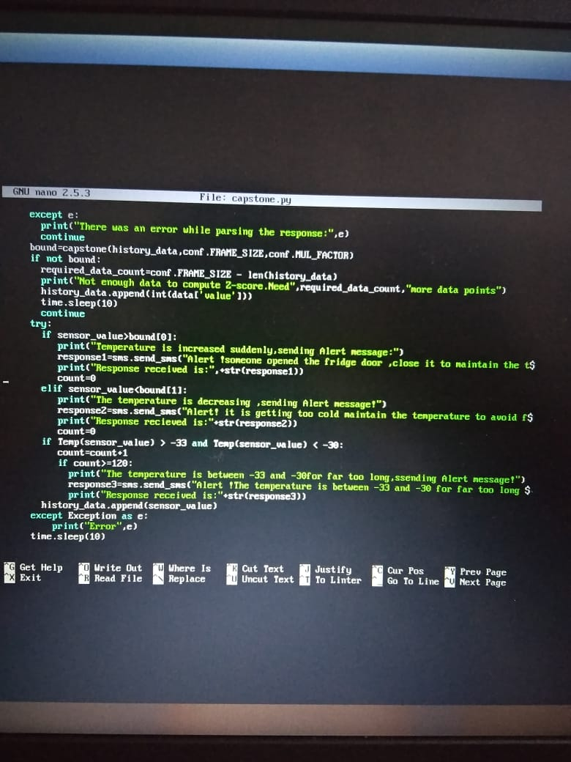
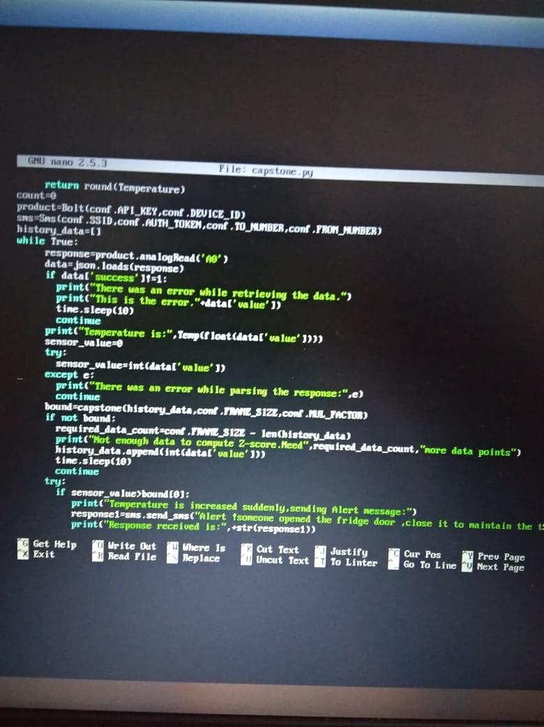
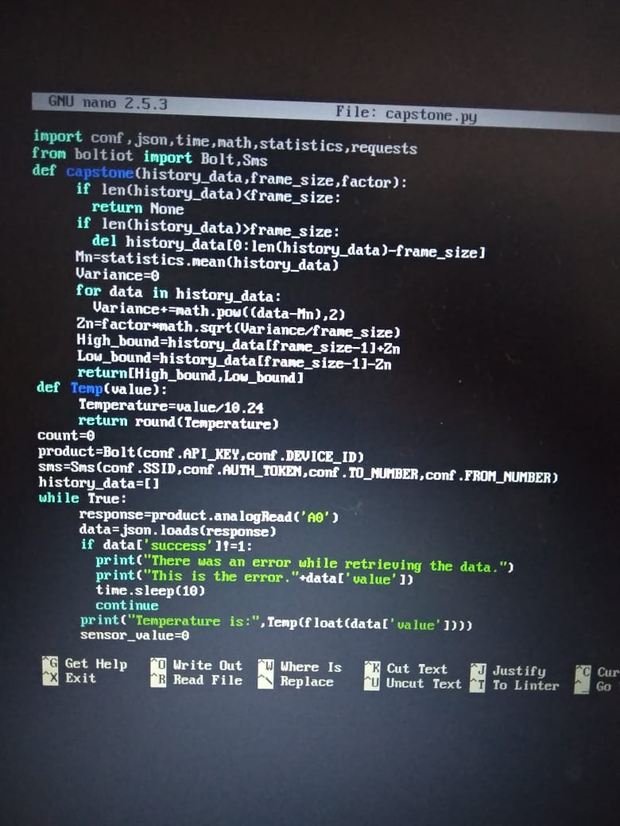

Slide 8
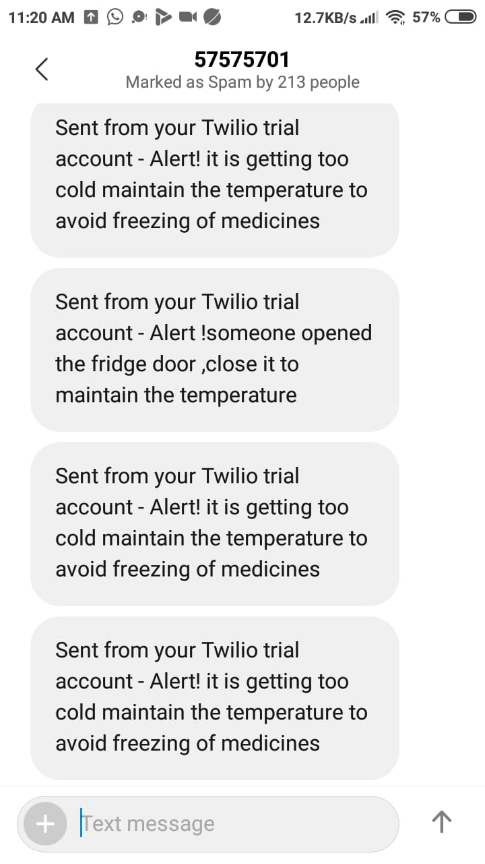
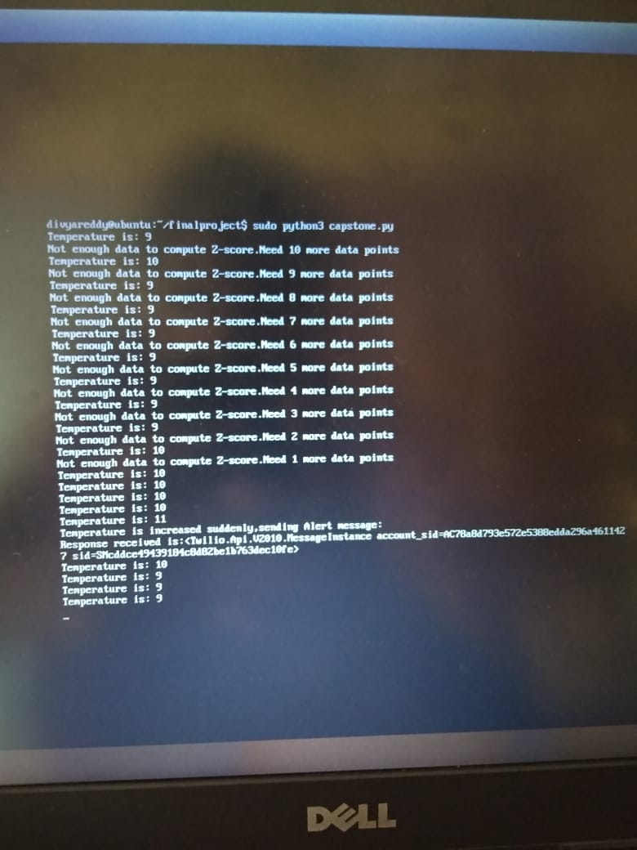
OUTPUT

